Slide 1
Statistics and Econometrics in Management
Pr Laurent Germain

Slide 2
Course Outline
Part 1: Statistics: Quantitative Method
Chapter 1: Descriptive Statistics
Introduction
Quantitative Data: measure of the central tendency (mean, median,etc) and the dispertion (var, standard deviation)
Bivariate Data
Methodology
Chapter 2: Probabilities - Normality
Introduction (definitions)
The Binomial Distribution
The Normal Distribution
Kurtosis and Skewness
Methodology

Slide 3
Course Outline
Part 1: Statistics: Quantitative Method
Chapter 3: Confidence Intervals
Introduction
Error Risk
Confidence Interval
Degree of Freedom
Case of Mean
Case of Proportion
Chapter 4: Hypothesis testing
Introduction
Model Hypothesis
Model Hypothesis: Two-sided Test
Model Hypothesis: One-sided Test
Type I error
Type II error
Methodology

Slide 4
Course Outline
Part 1: Statistics: Quantitative Method
Chapter 5: Statistical Tests
Introduction
Parametric tests
Chi Square tests
Non Parametric tests
Methodology
Chapter 6: Regressions
Introduction
Simple Linear Regression
Multiple Regression

Slide 5
Statistics in Management: Quantitative Method
Part 1

Slide 6
Introduction 1/2
Statistics in Management are used to process and analyse data. It also means to translate data into useful form for decision making.
Finance: Managing risk, forecast future expenditure, etc
Marketing: mining data about customer behaviour, study the effect of marketing decisions
Management: Collect and present data for better decision making
Production: Pricing of products
In this course, we will focus on the tools of what we use in Academic Background.

Slide 7
Introduction 2/2
What are Statistics?
Statistics are very important because it is the science that deals with the collection, classification, analysis, and interpretation of numerical facts or data, and that, by use of mathematical theories of probabilities, imposes order and regularity on aggregates of more or less disparate elements.
Econometrics are also important because thanks to some regressions and some models you can do some predictions
Statistics have the objective to give you an understanding of what your data means and how your hypothesis are true or not.
In the other hand econometrics are used to do the expectation.
To do so, we will divide this course in 8 topics (6 on statistics and 2 on econometrics):
Descriptive Statistics
Probabilities – Normality Distribution
Confidence Interval
Hypothesis
Statistical tests
Econometrics: Regressions
Econometrics : Time series Models
Econometrics : Non Linear Time Series Model

Slide 8
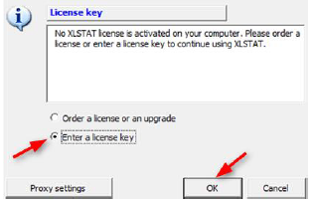
How can I instal XLSTAT ? (1/2)
If you do not have XLSTAT in your Excel program, you should download it in Campus Website:
Other services → Pedagogical Softwares
You should download the xlstat zip file depending on your computer if it is Mac or Windows.
When the file is downloaded you should click on next all the time.
For the activation of the XLSTAT
you need to enter a license key.
You can find the license key on the
PDF File : Procedure d’installation
Then you should Validate.

Slide 9
How can I instal XLSTAT ? (2/2)
As soon as XLSTAT is installing in your computer, if XLSTAT does not appear on the Ribbon, then you should:
Open a workbook in Microsoft Excel
Go on « File » Tab and click on « Options »
Then go on « Add ins »
If in Active Application Add-ins XLSTAT is not there but it is in Inactive Application Add-ins, then you should do: Manage → Catch up → Check XLSTAT Starter
Then a new tab appears on the command Ribbon: XLSTAT

Slide 10
Descriptive statistics
Chapter 1

Slide 11
Introduction 1/2
What are the Descriptive Statistics?
According to Weiss (1999), Descriptive Statistics consist of methods for organizing and summarizing information. It includes the construction of graphs, charts, tables and the calculation of various descriptive measures : Mean, variation, percentiles, etc.
We have to do a difference between two kinds of data
Qualitative Data : are the results of categorizing or describing attributes of a population
Example: gender, etc.
Quantitative Data : are the results of counting or measuring attributes of a population
Example: age, grades, etc.
In this part of the course, we will only focus on the Quantitative Data.

Slide 12
Introduction 2/2
Some important definitions:
A population: is the collection of all individuals or items under consideration in a statistical study.
A Data: Observations recorded during research (it can be quantitatitive or qualitative data: we will focus on this part only in quantitative data)
A sample: is that part of a population from which information is collected
A parameter is an unknown numerical summary of the population
A variable is any characteristic that varies from one individual member of the population to another. A variable can be quantitative or qualitative.
Each individual piece of data is called an observation and all the observation for particular variables is called data set.

Slide 13
Type of Data
Level | Data Type | Definition | Example
0 | Nominal | Data that has no order, and the assignment of numbers to categories is purely arbitrary | Ethnicity, age; gender
1 | Ordinal | Data that has order, but the intervals between scale points may be uneven. | Survey scales
2 | Interval | Data that has order and equal intervals but there is no natural zero | Temperature in fahrenheit
3 | Ratio | Ratio data are interval data which also have a true point. | Income

Slide 14
Quantitative Data (1/2)
Quantitative Data:
Used for :
Measuring the central tendency such as the mean, median, etc.
Measuring the dispersion of a sample using Variance, Standard Deviation.
Example:
Quantitative Data
 | Grade
Student 1 | 15
Student 2 | 12
Student 3 | 8
Student 4 | 14
Student 5 | 9
Student 6 | 10
Statistic | Grade
Nbr. of observations | 6
Minimum | 8,000
Maximum | 15,000
1st Quartile | 9,250
Median | 11,000
3rd Quartile | 13,500
Mean | 11,333
Variance | 7,867
Standard deviation | 2,805
Variation coefficient | 0,226

Slide 15
Quantitative Data (2/2)
Strengths:
It is clear and specific.
If properly analysed, quantitative data is accurate and reliable.
Can be easily communicated (charts, graphs)
Many large datasets already exist that can be analysed
Limitations:
Can require complex sampling procedures
May not accurately describe a complex situation
Requires some expertise with statistical analysis
Data collection method provide respondent with a limited number of response options

Slide 16
The Mean
Definition: The Mean is a measure of central location for a sample. It is used to calculate the arithmetic average of a sample.
Formula:
There are a lot of other means in statistics:
Geometrics Mean: the geometric mean is an appropriate measure to use for averaging rates.
Trimmed Mean: it s the mean without the higher and lower scores.

Slide 17
The Median
Definition: The Median is another measure of central location. It is used to divide the sample in two parts in which there are 50% of the sample in one side and 50% of the sample in the other side
Formula:
When to use it: The median is used to know where is the midpoint of a distribution.
Case: If the distribution of your data is symmetric, then the mean and the median and the mode are the same.

Slide 18
Quartile, Percentile
Definition: A Quartile is one of the values of a variable that divides the distribution of the variable into four groups having the equal frequency (First Quartile, Median, Third Quartile).
Definition: A Percentile is a measure indicating the value below which given percentage of observations in a group of observation. Quartiles are the 25th, 50th and 75th Percentiles.
Formulas:
First Quartile:
Third Quartile:
Percentile: where p is the desire percentile

Slide 19
Box Plots
With Quartiles you can realize Box Plots:
To do a Box Plots, see the slide « XLSTAT: Descriptive Statistics »
Let’s use the example above:
Statistic | Grade
Nbr. of observations | 6
Minimum | 8,000
Maximum | 15,000
1st Quartile | 9,250
Median | 11,000
3rd Quartile | 13,500
Mean | 11,333
Variance | 7,867
Standard deviation | 2,805
Variation coefficient | 0,226

Slide 20
The Variance
Definition: Considering the mean as the measure of the middle of the distribution, the variance is defined as the average squared difference of the scores from the mean.
Formula: with m is the mean and N the total number
In Descriptive Statistics, the variance is always calculated because it is important for the standard deviation.
A lot of tests needs the Variance and the standard deviation.

Slide 21
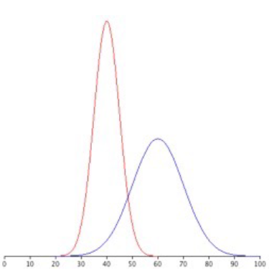
The Standard Deviation
Definition: The standard deviation is the square root of the variance. It is used to see the deviation of the mean.
Formula:
Example:
Normal distributions with standard deviations of 5 and 10
Coefficient of variation
The coefficient of variation measure how big the variation is in relative of terms.
Formula:

Slide 22
Others Common Descriptive Statistics
Range: The difference between the highest score and the lowest score.
Example: In the grades example, the Range is equal to 15 – 8 = 7
Minimum: The lowest or smallest score in a data set.
Example: In the grades example, the Minimum score is 8.
Maximum: The highest or largest score in a data set.
Example: In the grades example, the Maximum score is 15.
Frequency: The number of times a certain value appears.
Example: In the grades example, the frequency of 10 is 1, expressed as a percentage, the grade 10 appears 17% of the time.

Slide 23
Graphs: Introduction (1/4)
In general, quantitative data can be represented thanks to graphs, charts or tables.
That can be a good way to understand and to interpret the data.
The common graphs used are in Histograms, Line graphs or in scatter. That depend what you want to show with your data.
How can we do a graph or a chart?
To do a graph or a chart in excel you should do the following :
Select the data
Then, go to Insert → Charts
Choose the graph.

Slide 24
Graphs: Histograms (2/4)
In a histogram, the class frequencies are represented by bars. Each bar corresponds to its class frequency.
Why should you use histograms?
Graphs like histograms, let us see if our data are normally distributed. Even if you have to do normality tests, histograms are a pretty good approximation. (see the Chapter about Normality tests)
Example:

Slide 25
Graphs: Line Graphs (3/4)
A line graph is a bar graph with the tops of the bars represented by points joined by lines. Line graphs are a better option if you want to compare changes over time
Example:

Slide 26
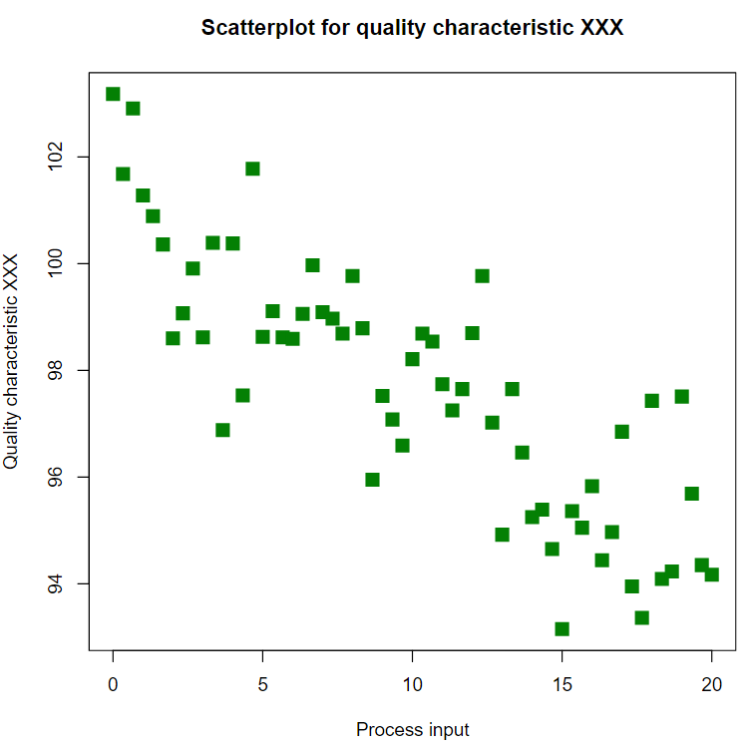
Graphs: Scatter Graphs (4/4)
In a histogram, the class frequencies are represented by bars. Each bar corresponds to its class frequency.
Why should we use a Scatter Plot?
The purpose of this graph is to identify th relationship between two quantitative variables. (see the Chapter about linear regression)
Example:

Slide 27
Bivariate Data: Introduction
Bivariate data is a dataset with two variables.
Each variable has its own mean, median, standard deviation etc.
Here, we will discuss the relationship between two variables.
Quantitative Data (Grades )
Men | Women
10 | 15
13 | 12
7 | 8
8 | 14
14 | 9
10 | 16

Slide 28
Bivariate Data: Correlation
As we can see on the example, each variable has his own descriptive data.
There is a statistical tool which is used to compare two variables: the correlation.
The correlation also called Pearson’s correlation (ρ) is calculated
standard deviation of X and Y

Slide 29
Bivariate Data: Correlation
Properties:
The values of the correlation lie between -1 and +1
If variables are not correlated the the correlation will be 0.

Slide 30
Methodology
You have to get your data
You should look carefully what kind of statistics you have: quantitative or qualitative.
You should check if there is no mistakes or blanks on the data
You do the Descriptive Statistics according to your type of data: Qualitative or Quantitative.
You can interpret your basic statistics.

Slide 31
Excel Formulas
Mean: =average(
Median: =median(
Variance: =var(
Standard Deviation: =stdev(
Covariance: =covariance.s(
Quartile: =quartile(
Maximum: =max(
Minimum: =min(
Correlation: =correl(

Slide 32
XL-Stat: Descriptive Statistics (1/4)
Go in XLSTAT →Describing data → Descriptive Statistics
In the case you do not need to have charts.
In « General » Tab :
Select your data in Quantitative Data or Qualitative Data depending on your sample.
Select where you want the descriptive data appears : Range, Sheet or workbook
I recommend you to check in Sheet because it would be easier to erase the data if you have done a mistake.
In « Options » Tab:
Check Descriptive Statistics
If you need a chart check the field Charts.
In « Outputs » Tab:
Depending on what kind of data you have filled in, you will have the possibility to choose your descriptive statistics: mean, variance, standard deviation, maximum, etc.
Then you click on OK and the Descriptive Statistics will appear.

Slide 33
XL-Stat: Descriptive Statistics (2/4)
In the case you do need to have charts.
You should follow the same framework as discussed in the last slide but in the « Options » Tab you should check the field « Charts »
Then In « Chart (1) » Tab, you should check the chart that you want: Boxplot, Scatter grams, etc.

Slide 34
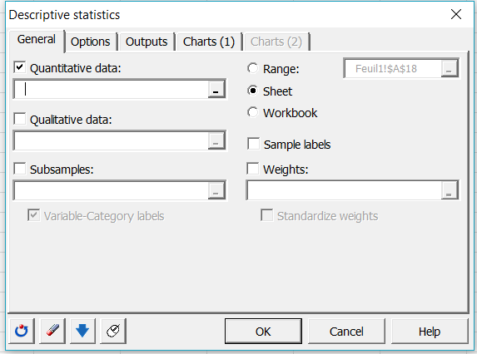
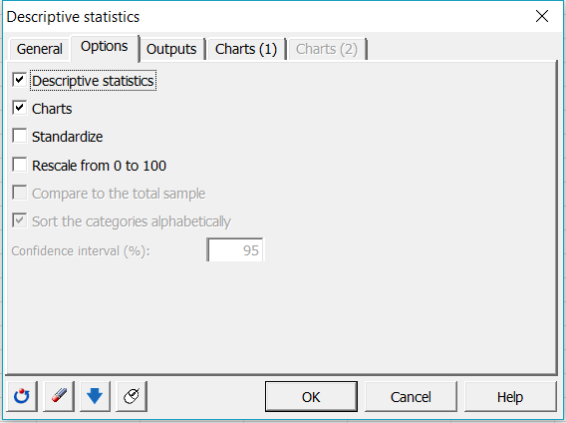
XL-Stat: Descriptive Statistics (3/4)
Click on Describing Data → Descriptive statistics
Select the location of your results
Select the options
Select your type of data

Slide 35
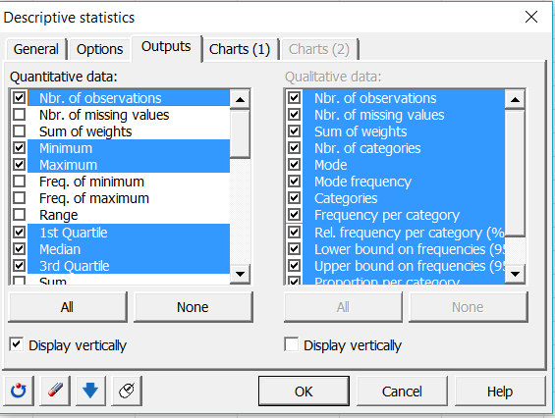
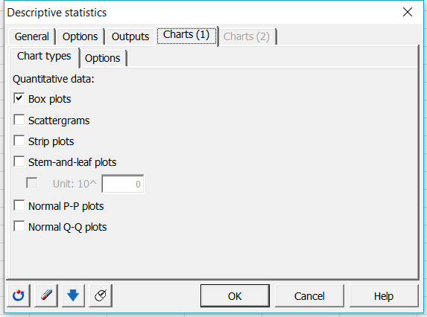
XL-Stat: Descriptive Statistics (4/4)
Select all the details you want
Select the types of chart
To get access to this Tab you need to check « Charts » in the Option Tab

Slide 36
Probabilities -Normality Distribution
Chapter 2

Slide 37
Introduction
Probabilities is a branch of mathematics that deals with calculating the likelihood of a given event’s occurrence, which is expressed as a number between 0 and 1
Formula:
Example:
When you toss a coin the probability of having « heads » or « nails » is ½.
With a dice with 6 faces: you will have the probability 1/6 to have 1 or 2 or 3 or 4 or 5 or 6.

Slide 38
Introduction: Some formulas
means: probability of A or B
means: probability of and B
Independent Variables:
Conditional Probabilities: A and B are not independent
P(B/A), it is the probability that B is going to be realized knowing that A is realized

Slide 39
Binomial Distribution
Binomial Distribution is a Random Variable containing a single piece of information: success with probability p and failure with probability 1-p
Definition: With and then X ~ B(n, p).
The probability is:
Where
Characteristics :
Mean:
Variance:
It is frequently used to model the number of successes in a sample of size n drawn with replacement from a population of size N.
Notes:
n! = 1x2x3x…xn

Slide 40
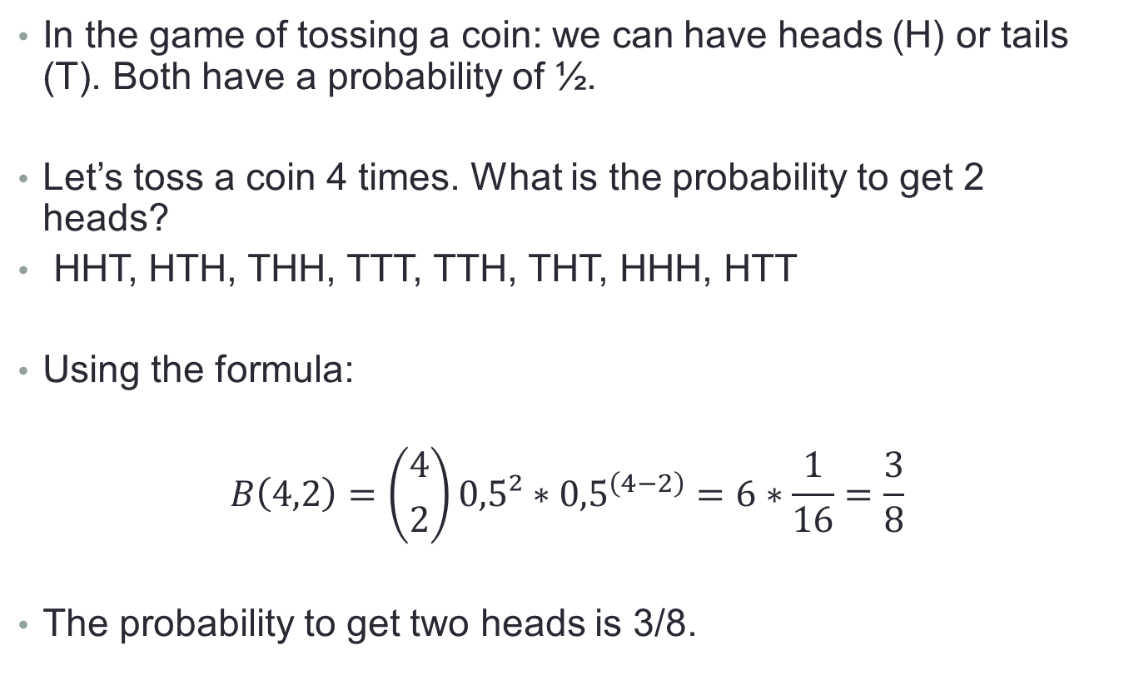
Binomial Distribution: Example
In the game of tossing a coin: we can have heads (H) or tails (T). Both have a probability of ½.
Let’s toss a coin 4 times. What is the probability to get 2 heads?
HHT, HTH, THH, TTT, TTH, THT, HHH, HTT
Using the formula:
$$B\left(4,2\right)=\left({4 \atop 2}\right)0,5²∗{0,5}^{\left(4−2\right)}=6∗\frac{1}{16}=\frac{3}{8}$$
The probability to get two heads is 3/8.

Slide 41
Poisson Distribution
Poisson Distribution is a Random Variable which expresses the probability of given number of events occurring in a fixed interval of time.
Formula:
With λ is the average number of events per interval
k takes the value 0,1,2,…
Characteristics :
Mean:
Variance:

Slide 42
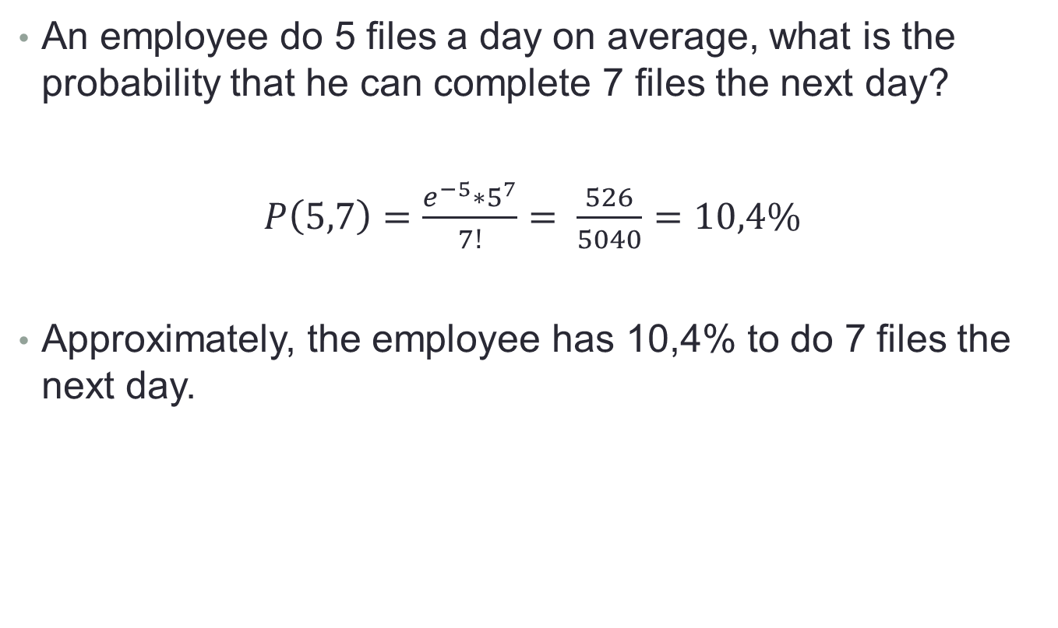
Poisson Distribution: Example
An employee do 5 files a day on average, what is the probability that he can complete 7 files the next day?
$P\left(5,7\right)=\frac{e^{−5}∗5^{7}}{7!}= \frac{526}{5040}=10,4\%$
Approximately, the employee has 10,4% to do 7 files the next day.

Slide 43
Hypergeometric Distribution
Definition:This distribution is a discrete probability distribution that describes the probability of k successes in n draws, without replacement from a finite population of size N that contains exactly K successes.
Formula:
With N is the population size,
K is the number of success states in the population,
n is the number of draws
k is the number of observed successes
Characteristics :
Mean:
Variance:

Slide 44
Hypergeometric Distribution: Example
You have an urn of 100 balls : 50 red and 50 black. You randomly select 5 balls without replacement, then you count the number of red marbles you have selected.
The difference with the binomial distribution is that we do not have the probability of success on every trial.
At the beginning of the game, the probability was 0,5. Then the probability will change according to your draw.

Slide 45
Normal Distribution: Definition (1/6)
Definition: A continuous random variable X is said to be normally distributed or to have a normal distribution if its density curve is a symmetric, bell-shaped curve, characterized by its mean μ and standard deviation σ. For each fixed number z, the probability concentrated within interval [μ − z, μ + z] is the same for all normal distributions.
A random variable X following normal distribution with a mean of μ and a standard deviation of σ is denoted by X~N(μ, σ).

Slide 46
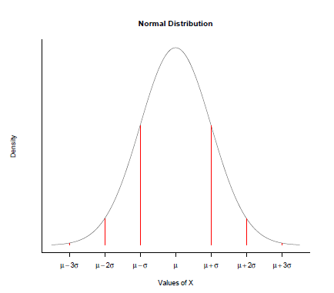

Normal Distribution: Definition (2/6)
The density function is:
$$f\left(x\right)= \frac{1}{σ\sqrt{2π}}e^{−\frac{1}{2}(\frac{x−μ}{σ})²}$$

Slide 47
Normal Distribution: Definition (3/6)
Main characterisitics:
Depends on the mean and the standard deviation of the data
The distribution of observation is symmetric comparing to the mean
More the values are far to the mean, less there are observations.
Properties:
Mean = Median = Mode
99% of observations belong to [m - 3σ ; m + 3σ]
95% of observations belong to [m - 2σ ; m + 2σ]
68% of observations belong to [m - σ; m +σ]
The symmetry is measured by the « Skweness »
The tailledness is measured by the « Kurtosis »

Slide 48
Normal Distribution: Shape (4/6)
f(X)
Changing μ shifts the distribution left or right.
Changing σ increases or decreases the spread.
μ
X

Slide 49
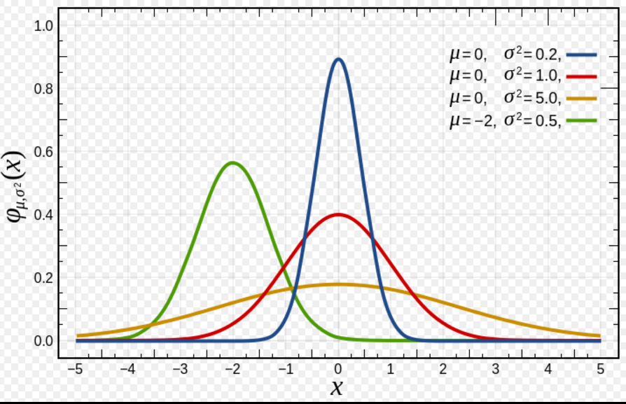
Normal Distribution: Standard Case (5/6)
Definition: A continuous random variable Z is said to have a standard normal distribution if Z is normally distributed with mean μ = 0 and standard deviation σ = 1, i.e., Z ~N(0, 1).

Slide 50
Normal Distribution (6/6)
Why should we study the normality of our data?
We have to study the normality of our data because the normality tests are the first step of many steps for our research: as soon as you know that your data follow a normal distribution you can do Parametric tests if your data does not follow a normal distribution then you should do Non Parametric Tests. ( We will study this in the Chapter 5)
How can we see if a variable follow a normal law N(m; o):
Study of the skewness and kurtosis
Study of the histograms
Study of graphs pp plot
Study of the normality tests

Slide 51
Kurtosis (1/2)
Definition: Kurtosis is a measure of the « tailledness » of the probability distribution of a real valued random variable.
Kurtosis < 3 | Kurtosis = 3 | Kurtosis > 3
The tail of the probability distribution is flat. | The tail of the probability distribution is normal. | The tail of the probability distribution is straight.
Platykurtic | Mesokurtic (Normal) | Leptokurtic

Slide 52
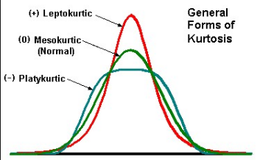
Kurtosis (2/2)
You can see the value of your Kurtosis in the Descriptive Statistics

Slide 53
Skewness (1/2)
Definition: Skewness is a measure of the asymmetry of the probability distribution of a real valued random variable.
Skewness < 0 | Skewness = 0 | Skewness > 0
The tail of the probability distribution is on the left side. | The tail of the probability distribution is normal. | The tail of the probability distribution is on the right side.

Slide 54
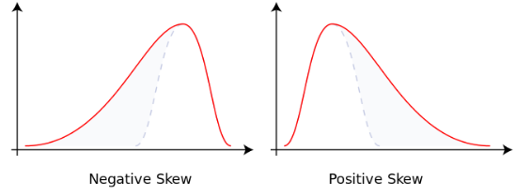
Skewness (2/2)
You can see the value of your Skewness in the Descriptive Statistics

Slide 55
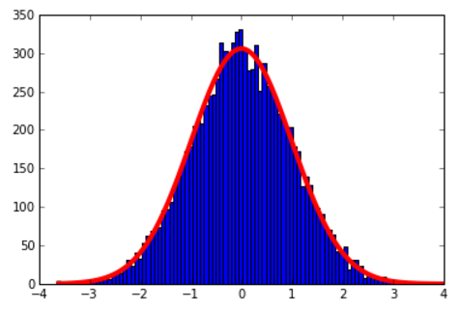
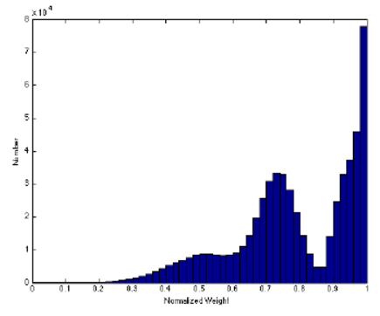
Histograms
As we saw in the Chapter 1, Histograms can be a good way to see if the distribution of data can follow a Normal Distribution.

Slide 56

Normality Tests: Shapiro–Wilk Test (1/7)
H₀ : the series is normally distributed
H₁ : the series is not normally distributed
: number of observations
: constant generated by the mean and matrix of variance and covariance following a normal distribution
This test is very powerful with n<50
We reject H₀ if pvalue < α
In addition to the test, a Q-Q plot is required for verification.

Slide 57
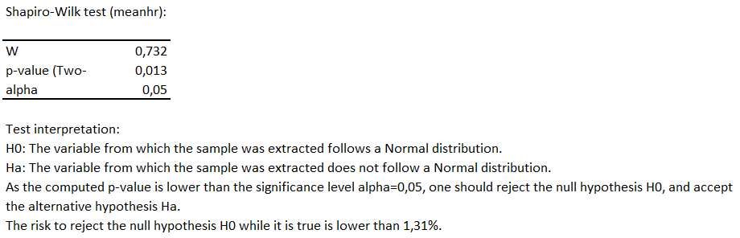
Normality Tests: Shapiro–Wilk Test (2/7)
Using XLSTAT, you will find the following results:
So you can conclude that pvalue <α, so you reject the hypothesis that the sample follow a Normal Distribution.
On the right you can see the Q-Q plot.

Slide 58
Normality Tests: Anderson-Darling Test (3/7)
H₀ : the data follow a specify distribution
H₁ : the data do not follow the specified distribution
The Anderson-Darling test statistic is defined as
F is the cumulative distribution function of the specified distribution.
The Anderson-Darling test can be used to answer the following questions:
Are the data from a normal distribution?
Are the data from a log-normal distribution?
Are the data from a Weibull distribution?
Are the data from an exponential distribution?
Are the data from a logistic distribution?

Slide 59
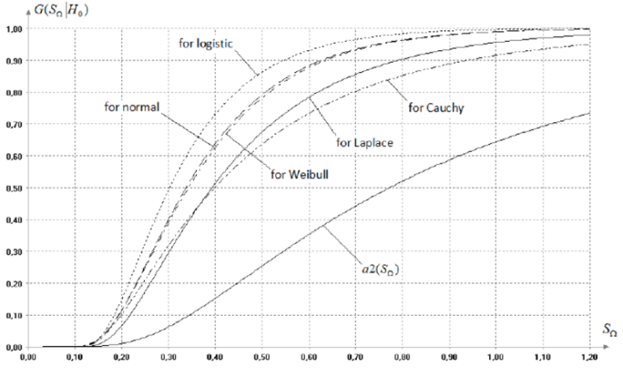
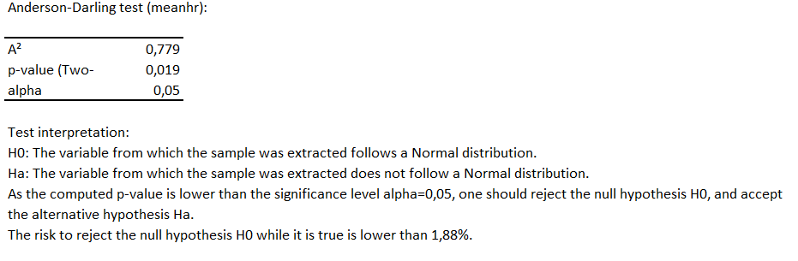
Normality Tests: Anderson-Darling Test (4/7)
Using XLSTAT, you will find the following results:
So you can conclude that pvalue<α, so you reject the hypothesis that the sample follow a Normal Distribution.

Slide 60
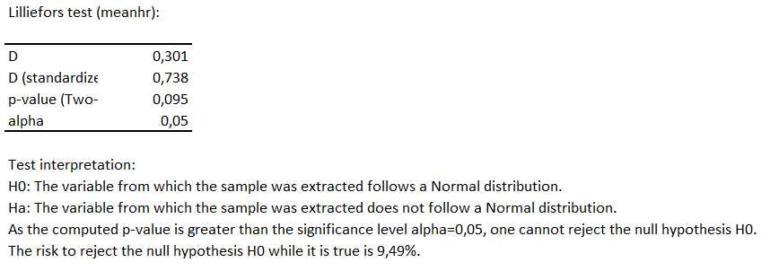
Normality Tests: Lilliefors Test (5/7)
Lilliefors is another test which can test the normality hypothesis.
Using XLSTAT, you will find the following results:
So you can conclude that pvalue<α, so you reject the hypothesis that the sample follow a Normal Distribution.

Slide 61
Normality Tests: Jarque-Bera Test (6/7)
H0 : the series is normally distributed
H1 : the series is not normally distributed
JB ≈ CHI2 (2 dof)
T : number of observations
k : number of explanatory variables in if the normality of regression residuals is tested, 0 otherwise
S : Skewness
K : Kurtosis
α : risk level
We reject H0 if JB > χ²_{2;1-α} or if pvalue < α

Slide 62
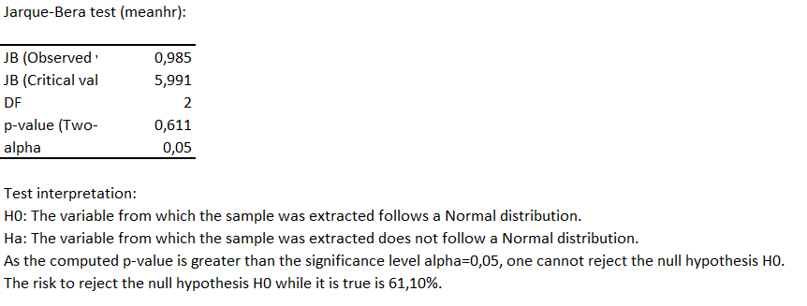
Normality Tests: Jarque-Bera Test (7/7)
Using XLSTAT, you will find the following results:
So you can conclude that pvalue<α, so you reject the hypothesis that the sample follow a Normal Distribution.

Slide 63
Normality Tests: Summary
Test: | When to use it?
Shapiro-Wilk Test | This test is used when there is an unspecified mean and variance.
Anderson-Darling Test | This test compares the empirical cumulative distribution function of your sample data with the distribution expected if the data were normal.
Lilliefors Test | It can be used when you don t know the population mean or the standard deviation.
Jarque-Bera Test | This test is the most common. Usually used for large data.

Slide 64
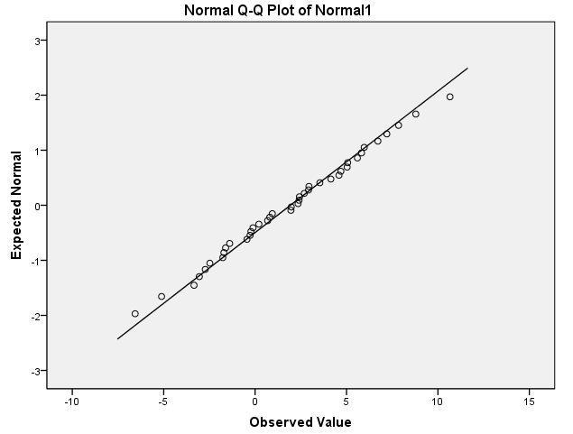
Charts: P-P plots
A P-P plot (Probability – Probability Plot) compares the empirical cumulative distribution function of a data set with a specified theoretical cumulative distribution function.

Slide 65
Charts: Q-Q plots
It is a graphical technique for determining if two data sets come from populations with a common distribution.
The quantile-quantile plot (Q-Q Plot) is a plot of quantiles of the first data set against the quantiles of the second data set.
The Q-Q plot will be close to a straight line if the assumed density is correct.

Slide 66
Normality tests: Example (1/2)
A manager wants to evaluate the work’s quality of his employees. After one week of evaluation, he got the following grades:
Do the grades follow a normal distribution?
Employee | A | B | C | D | E | F | G | H | I | J | K
Grade | 12 | 14 | 18 | 10 | 11 | 13 | 17 | 15 | 8 | 12 | 14

Slide 67
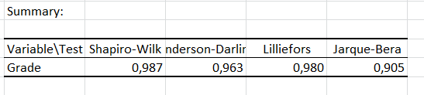
Normality tests: Example (2/2)
Here we can use every normality test. In this example all the tests has the same result.
The grades do not follow a normal distribution. This means that if you want to do more other test, they should be non parametric test.
Remember: Normality tests are used to know what kind of data and test we can realize : parametric or non parametric (chapter 5)

Slide 68
Methodology
After getting the Descriptive Statistics, you have to see if your data are normally distributed or not.
You select the data
In Descriptive Statistics, you can already see the Skewness ans Kurtosis of the data.
To confirm the normality, you should do one or more normality test:
Under Normality Tests: Jaques Bera, etc.
Under the form of graphs: P-P Plot or Q-Q Plot.
You will know if your data are following a normal distribution or not.

Slide 69
XL-STAT: Normality Tests (1/2)
Go in XLSTAT →Describing data → Normality Tests
In « General » Tab :
Select your data on « Data » and if you have a proportion check the case « Weight s» and select your weights .
Select where you want the normality tests appears : Range, Sheet or workbook
I recommend you to check in Sheet because it would be easier to erase the data if you have done a mlstake.
Check the normality test in which you are interested: you can check all of them.
If you have labels, do not forget to check in « Sample Labels », in that case you should include your label in your selection in « Data ».
In « Missing Data » Tab:
Depending on your data you can choose the method if there is missing data
In « Outputs » Tab:
As you can see you can have also the Descriptive Statistics.
In « Charts » Tab:
You can select the kind of chart you want..
Then you click on OK and the Normality tests will appear.

Slide 70
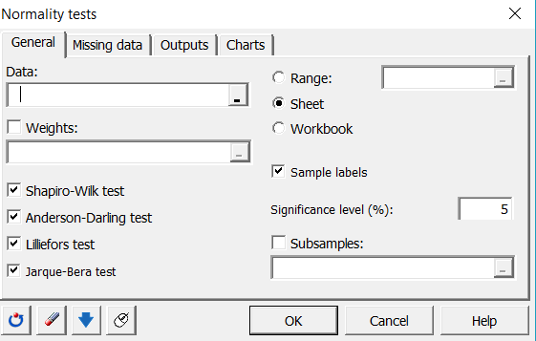
XL-Stat: Normality Tests (2/2)
Click on Describing Data → Normality Tests
Select the location of your results
Select your type of data
Select the Normality tests

Slide 71
CONfidence Interval
Chapter 3

Slide 72
Introduction
Confidence Interval gives an estimated range of values which is likely to include an unknown population parameter, the estimated range being calculated from a given set of sample data..
In other words, Confidence interval are two extremes of measurement within which 95% of observation would lie.
Usually, you take 99%, 95% or 90% confidence interval.
Example: You are studying the evolution of the sales in the pharmaceutical sector in the world. It would be not very easy to get all the information company by company. So, you will take a sample of 50 companies and you will do an estimation. You are not sure that your estimation is 100% true so you are sure at 95% that your estimation is true: this is the confidence interval.

Slide 73
Error Risk
With the notion of Confidence Interval another notion appears: it is the risk error α.
This risk error is the risk in which the estimation can be very different of our sample/ data.
In statistics the risk error is often 1%, 5% or 10%
Usually, we used α = 5%
Important: A Type I error occurs when a significance test results in the rejection of a true null hypothesis.
The lower the α level the lower the Type I error rate.
α is the probability of a Type I error given that the null hypothesis is true.

Slide 74
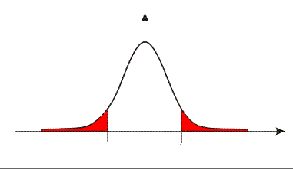
Confidence Interval
When you will have estimated the sample, we calculate the parameter i or the margin error associated to the parameter: [parameter – i ; parameter +i]
The true value of the parameter will be in the confidence interval with a risk α.
α can be 1%, 5% or 10%
There is (1- α )% of chance that the true value of the parameter belongs to the interval
parameter: [parameter – i ; parameter +i]
The calculation of the parameter i will be different if it is for the case of a mean or for the case of a proportion.
1- α
α /2
α /2
i
i
parameter- i
parameter+ i
_{parameter}

Slide 75
Degrees of Freedom
Definition: The degrees of freedom (dof) is the number of independent pieces of information on which the estimate is based.
Degrees of freedom = n - 1
Example: You have to form a group of 10 person and for each person you will give him a specific task. There are 10 tasks. You will give to the first person one of ten task, to the second one of nine, … That leads you to the tenth person. You have no choice to give to the tenth person the remaining task so there is not a « free task » left. So here: dof = 10 – 1 = 9

Slide 76
Case of the Mean (1/3)
X is a random variable of the sample (X,…, X)
The arithmetic mean is :
If n>30 then we can use the Central Limit Theorem, me follow a Normal distribution or
follow a normal distribution N(0;1)

Slide 77
Case of the Mean : Calculation of the parameter i (2/3)
i is the parameter of the uncertainty, it is also called the margin error.
α is the risk error
is the standard deviation of the sample
tα/2 is calculated thanks to the Standard Normal Distribution N(0;1) : it s called the Critical Value
α = | 1% | 5% | 10%
tα/2 = | 2,57 | 1,96 | 1,645

Slide 78
Case of the Mean : Example (3/3)
The marketing department of Zopiac are doing a market study of pharmaceutical products. They test the hypothesis that the mean price of the product is 20 euros. Their sample of 100 of products gives them a mean of 17 euros and the standard deviation is 5 euros.
Can we conclude the marketing department hypothesis is true?
Let’s calculate the Confidence interval:
There are 95% of chance that the real mean is between 15 and 19.
So we cannot conclude with a risk of 5% that the hypothesis mean of 20 euros is true.
α = | n | m_{e} | σ_{e} | tα/2 | i | Binf | Bsup
5% | 100 | 17 | 5 | 1,96 | 2 | 15 | 19

Slide 79
Case of the Proportion (1/3)
X is a random variable of the sample (X,…, X)
The arithmetic mean is :
If n>30 then we can use the Central Limit Theorem, me follow a Normal distribution or
follow a normal distribution N(0;1)

Slide 80
Case of the Proportion : Calculation of the parameter i (2/3)
i is the parameter of the uncertainty, it is also called the margin error.
α is the risk error
is the proportion of the sample
tα/2 is calculated thanks to the Standard Normal Distribution N(0;1): it s called the Critical Value
α = | 1% | 5% | 10%
tα/2 = | 2,57 | 1,96 | 1,645

Slide 81
Case of the Proportion : Example (3/3)
During elections for employee commissionaire of a company, there are only two candidates: Mr. O and Mrs Z. A survey realized with 2000 people give 65% of vote for Mrs Z.
Can we consider with a risk at 5% that Mrs Z will be elected?
Let’s calculate the Confidence interval:
With 5% of risk, we can conclude that Mrs Z will be elected because the confidence interval is [62,9%; 67,1%] which is higher than 50%.
α = | n | p_{e} | tα/2 | i | Binf | Bsup
5% | 2000 | 65% | 1,96 | 2,1% | 62,9% | 67,1%

Slide 82
Conclusion
 | Mean | Proportion
Calcul of the Uncertainty I
Calcul of the Confidence Interval

Slide 83
Hypothesis testing
Chapter 4

Slide 84
Introduction
In this chapter, we will study the Hypothesis testing. This consists in knowing if data are in tune with the idea.
Example: In a city with one hundred of individuals, you think that there are fifty men and fifty women. You will do an hypothesis test to know if your hypothesis is correct.
In this chapter we will study:
Model of Hypothesis
Types Error

Slide 85
Model of Hypothesis Testing (1/7)
Definition: Hypothesis Testing is a way consisting in rejecting or accepting a statistical hypothesis called the null hypothesis (H₀), depending on the data.
H₀, the null hypothesis is always against what we expect to find
H₁, the alternative hypothesis is the idea what we expect to find
When the null hypothesis is rejected, the effect is said to be statistically significant.

Slide 86
Model of Hypothesis Testing (2/7)
How can we know when we should accept an hypothesis?
The p-value is defined as the smallest value of alpha for which the null hypthesis can be rejected
When you will do your test, you will see the p-value. If the p-value is below the alpha (0,05 most of the time) then the null hypothesis is rejected.
Moreover, when you do the tests on XLSTAT, you will see the directly the interpretation.

Slide 87
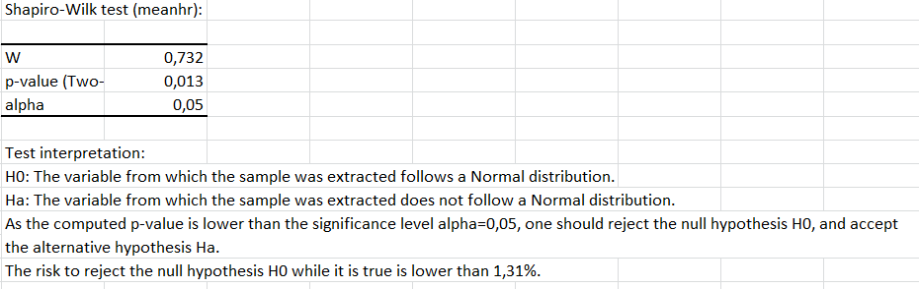
Model of Hypothesis Testing (3/7)
Example of Normality test:
The null hypothesis H₀ is the variable follows a Normal Distribution
The alternative hypothesis H₁ is the variable does not follow a Normal Distribution
P-value < alpha
Interpretation of the test

Slide 88
Model of Hypothesis Testing (4/7)
3 types of tests
Two-sided test
One-sided test
(right tail)
One-sided test
(left tail)

Slide 89
Model of Hypothesis Testing: Two-sided test (5/7)
Two-tailed test are more common in scientific research
When a p-value is below the α level, the effect is statistically significant and the null hypothesis is rejectected.
The rejection is split between two sides of distribution
The difference could be in both direction/ possibility
Two-sided test

Slide 90
Model of Hypothesis Testing: one-sided test (6/7)
One tailed tests are appropriate when it is not important to distinguish between no effect and an effect in the unexpected direction.
When a p-value is below the α level, the effect is statistically significant and the null hypothesis is rejectected.
The rejection is in one or other tail of distribution
One-sided test
(right tail)
One-sided test
(left tail)

Slide 91
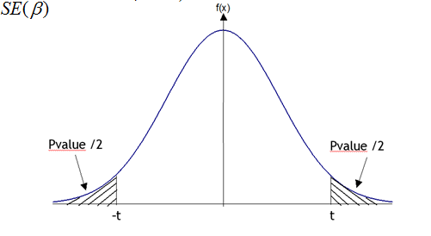
Model of Hypothesis Testing: Summary (7/7)
One sided test (left) | Two sided test | One sided test (right)
H₀ : m = m₀ H₁ : m < m₀ | H₀ : m = m₀ H₁ : m ≠ m₀ | H₀ : m = m₀ H₁ : m > m₀

Slide 92
Type I error
Type I error:
It is probability of finding difference, when no such difference actually exits
Acceptance of inactive compound
It is also known as α error / false positive
Level of significance:
The probability of committing Type I error
Denoted by α
Level of significance of 0,05% means → risk of making wrong decisions only is 5 out of 100 cases (95% confident)

Slide 93
Type error II
Type II error:
It is probability of inability to detect difference when such difference actually exists, thus resulting in rejection of active compound as inactive
It is called as β error / false negative.
Power of the test:
It is probability of committing Type II error.
Denoted by β and 1- β is power of the test
Power is the probability of rejecting H₀ when H₀ is false (in other words, correct decision)

Slide 94
Methodology
For a two-tailed test, the null hypothesis is typically that a parameter equals zero although there are exceptions. A typical null hypothesis is μ1 - μ2 = 0 which is equivalent to μ1 = μ2. For a one-tailed test, the null hypothesis is either that a parameter is greater than or equal to zero or that a parameter is less than or equal to zero. If the prediction is that μ1 is larger than μ2, then the null hypothesis (the reverse of the prediction) is μ2 - μ1 ≥ 0. This is equivalent to μ1 ≤ μ2.
The second step is to specify the α level which is also known as the significance level. Typical values are 0.05 and 0.01.
The third step is to compute the probability value (also known as the p value). This is the probability of obtaining a sample statistic as different or more different from the parameter specified in the null hypothesis given that the null hypothesis is true.
Finally, compare the probability value with the α level. If the probability value is lower then you reject the null hypothesis.

Slide 95
Statistical tests
Chapter 5

Slide 96
Introduction
Statistical tests are used to control if data are ok with an hypothesis.
Earlier we have seen one kind of tests: normality tests
It is used to see if data are following a normal distribution or not
Remember, if data follows a normality distribution, then you should do Parametric Tests, otherwise you should do No Parametric tests.
In this chapter we will see:
Parametric tests such as student test or ANOVA
Tests no parametric such as CHI-2

Slide 97
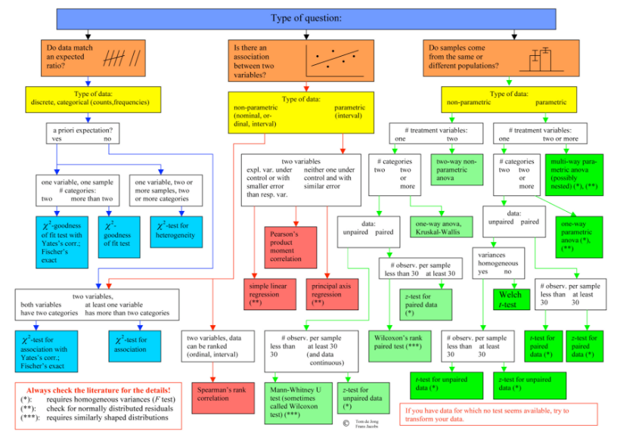

Slide 98
Tests
Parametric Tests | Non Parametric Tests
Student’s test (One Sample t-test, One sample z-test) | One Sample sign test, One sample Wilcoxon Signed Rank test
Two-Way ANOVA | Krustal-Wallis test
One-Way ANOVA | Friedman test
Independent samples t-test | Mann-Whitney Test
One-Way ANOVA | Mood’s Median Test
Correlation Coefficient | Spearman Rank Correlation

Slide 99
Parametric Tests: Definition
We will use a parametric trest if the information about the population is completely known by means of its parameters.
They must be normally distributed, that is why you should do a normality test before any other statistical test.
The null hypothesis is made on parameters of the population distribution.
Example: Student test (or t test), f test, z test, Anova

Slide 100
Parametric Tests: Parameters
Large sample: sample of size has to be higher than 30
Small sample: sample of size has to be smaller or equal to 30.
Larger the sample, better the statistics.
To do a Parametric tests, your sample has to respect the following conditions:
The samples have to be independent. And the number of observations has to be large.
The observations has to follow a Normal distribution.

Slide 101
Z-test
A z-test is used for testing the mean of a population versus a standard, or comparing the means of two populations with large samples.
It is also used for testing the proportion of some characteristic versus a standard proportion, or comparing the proportion of two populations.

Slide 102
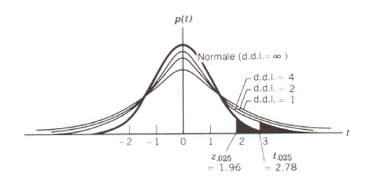
Student’s t-test : Student Distribution
Definition:
If X~N(0;1) and Y~χ²(n) with X et Y independent variables, then:
is T(n)
➔ Student distributed with n degrees of freedom (dof)
➔ When n>30 T(n)~N(0,1)

Slide 103
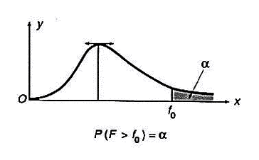
Student’s t-test: Fisher Distribution
Definition:
Let X et Y two independent variables with X~χ²(n) and Y~χ²(p), then:
is F(n;p)
➔ Fisher distributed with n and p degrees of freedom

Slide 104
Student’s t-test: One sample t-test
Assumptions:
Data are continuous from a single random sample
The test assume the population is normally distributed
Sample has to be equal or greater than 30.
In the one-sample t-test, the null hypothesis is that the observed mean is equal to a specify value (theoretical mean)
We can use it in XLSTAT:
Parametric tests → One sample t test and z test

Slide 105
Student’s t-test: on two independent samples
Assumptions:
Samples must be independent, there can be no relationship between the two samples
Population must be normally distributed and standard deviation known (sample size > 30)
Should not be used if more than two means are tested unless adjustments are made to significance levels
Hypothesis
The null Hypothesis is means are identical
We can use it in XLSTAT:
Parametric tests → Two samples t test and z test

Slide 106
Student’s t-test: on two paired samples
The paired sample t-test is a statistical procedure used to determine whether the mean difference between two sets of observations is zero.
Assumptions:
The dependent variable must be continuous.
The observations are independent of one another.
The dependent variable should be approximately normally distributed.
The dependent variable should not contain any outliers
Hypothesis
The null Hypothesis is means are identical
The two-tailed alternative hypothesis assumes that is not equal to zero.
The upper-tailed alternative hypothesis assumes that is greater than zero.
The lower-tailed alternative hypothesis assumes that is less than zero.
We can use it in XLSTAT:
Parametric tests → Two samples t test and z test

Slide 107
Student’s t-test: Summary
Test | Hypothesis | Statistics | Reject of H₀
Test with a mean and a standard deviation known | H₀ : m=m₀ contre H₁ : m≠m₀ ou m<m₀ ou m>m₀ | Under H₀, T= Follows a normal distribution N(0;1) | Si |T|>t_{α/2} ou T< - t_{α} ou T> t_{α}
Test with a mean, and a standard deviation unknown | H₀ : m=m₀ contre H₁ : m≠m₀ ou m<m₀ ou m>m₀ | Sous H₀, T= Follows a Student distribution(n-1) | Si |T|>t_{α/2} ou T< - t_{α} ou T> t_{α}

Slide 108
Student’s t-test: Example
After studying the evolution of the telecommunication industry, we suppose that the time spent on the phone is 20 hours per person and per year. A survey in which 500 person have participated, gives us a mean of 23 hours woth a standard deviation of 3. Does our hypotesis is included in this survey?
The test here is H₀: m = 20 against H₁: m ≠ 20
The statistical test is: T=(23-20)/3=1
In the course of Confidence Interval, we know that the value for t_{α/2} with a risk at 5% is 1,96.
Here T<1,96 so we cannot reject the null hypothesis..
n | Mean | Standard Deviation
500 | 23 | 3

Slide 109
Correlation Coefficient
Correlation Coefficient is a measure of the linear correlation between two variables.
This measure is used in general used for linear regression.
The value can be between [-1,1].
0 is no linear correlation
- 1 is total negative correlation
+1 is total positive correlation
We can use it in XLSTAT:
Correlation/ Association tests → Correlation tests

Slide 110
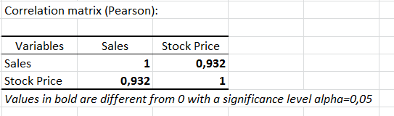
Correlation Coefficient: Example
A manager wants to calculate the correlation between the stock price and the sales per year for 5 years.
We can see that the correlation between the two variables is strong because it is near 1..
Year | 1 | 2 | 3 | 4 | 5
Sales | 120 | 155 | 123 | 160 | 178
Stock Price | 12,50 | 13,20 | 12,60 | 13,8 | 15,2

Slide 111
XL-STAT: Parametric Tests (1/2)
Go in XLSTAT →Parametric tests→ Choose according to your sample
For every Parametric tests:
In « General » Tab :Select your data on « Sample»
Select the format of your data.
In Tests: select what tests fit you
Select where you want the tests : Range, Sheet or workbook
In « Options » Tab :
Alternative Hypothesis: choose what fits you.
The significance level is 5% most all the time.
Check Asymptotic p-value

Slide 112
XL-STAT: Parametric Tests (2/2)
In « Outputs » Tab:
As you can see you can have also the Descriptive Statistics, Confidence interval, Detailed Results, Summary of comparisons, etc
In « Charts » Tab:
You can select the kind of chart you want..
Then you click on OK and the tests will appear.

Slide 113
ANOVA: Definition
Analysis of Variance (ANOVA) is a statistical method used to test differences between two or more means.
ANOVA is a method for testing differences among means by analysing variance.
ANOVA tests the non-specific null hypothesis that all the population means are equal.
If the null hypothesis is rejected that means at least one population mean is different from at least one other mean.
Limitation: ANOVA does not give you what mean is different.

Slide 114
ANOVA: a One-Way ANOVA
It compares three or more unmatched groups when data are categorized in one way.
The null Hypothesis is H₀, m1 = m2 =…=mk
Y is the quantitative variable
X is the factor, qualitative variable with K modalities
Purpose: Measure the influence of the Qualitative variable X on the quantitative variable Y.

Slide 115
ANOVA: A Two-Way ANOVA
A Two-Way ANOVA is used to determine the effect of two nominal predictor variables on a continuous outcome variable.
A Two-Way ANOVA test analyses the effect of the independent variables on the expected outcome along with their relationship to the outcome itself.

Slide 116
ANOVA: Example (1/2)
The seller of IPEE wants to change the color of his goods (boards) but he does not know what color is going to be selled the most. He decides to study the sell of two colors : blue and red. The study lasts four days.
Day | Sales | Color
1 | 10 | Blue
1 | 12 | Red
2 | 15 | Blue
2 | 8 | Red
3 | 13 | Blue
2 | 6 | Red
4 | 11 | Blue
4 | 12 | Red

Slide 117
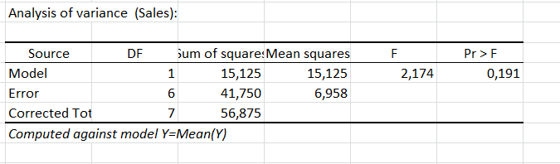
ANOVA: Example (2/2)
Question: Have the color an influence on the sales?
Hypothesis:
H₀ the color of the board does not influence the sales
H₁ the color of the board influences the sales
Results:
The statistic test F=2,174
The p-value is 0,191 > 5% so we accept the H₀ hypothesis.

Slide 118
XL-STAT: Parametric Tests (1/2)
Go in XLSTAT →Modelling Data→ Choos e according to your sample
For every Parametric tests:
In « General » Tab :Select your data on « Sample»
Select the format of your data.
In Tests: select what tests fit you
Select where you want the tests : Range, Sheet or workbook
In « Options » Tab :
Alternative Hypothesis: choose what fits you.
The significance level is 5% most all the time.
Check Asymptotic p-value

Slide 119
XL-STAT: Parametric Tests (2/2)
In « Outputs » Tab:
As you can see you can have also the Descriptive Statistics, Confidence interval, Detailed Results, Summary of comparaisons, etc
In « Charts » Tab:
You can select the kind of chart you want..
Then you click on OK and the tests will appear.

Slide 120
Nonparametric Tests: Definition
We will use a nonparametric test if there is no knowledge about the population or parameters, but still is required to test the hypothesis of the population.
They are not normally distributed, that is why you should do a normality test before any other statistical test.
The null hypothesis is free from parameters.
Example: Mann-Whitney, Rank-Sum test, Krustal-Wallis test, etc

Slide 121
Chi-Square: Chi-Square Distribution
The Chi-Square is one of the most used case of nonparametric tests.
The Chi-Square statistics is used to:
Determine if a distribution of observed frequencies differs from the theoretical expected frequencies.
H₀: distribution follows a normal distribution
H₁: distribution does not follow a normal distribution
Control the representativity of a sample:
H₀: distribution is in accordance with the quotas
H₁: distribution is not in accordance woth the quotas
Determine if there is a link between two variables:
H₀: 2 variables are idenpendent
H₁: 2 variables are dependent
.

Slide 122
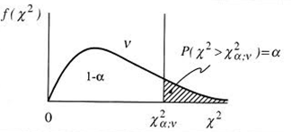
Chi-Square: Chi-Square Distribution
Definition:
Let (X₁,X₂ ,…,X_{n}) a sample with gaussian distribution N(0;1).
Then:
is χ²(n)
F_{o}: Observed Frequency
F_{e}: Expected Frequency
➔ Chi square distributed with n degrees of freedom (dof)

Slide 123
Chi-Square: Test Results
.If X² > X²_{αv} with the risk alpha given and for a degree of freedom given v, Chi-Square is significatif with a risk and we reject H₀
If X² < X²_{αv} with a risk alpha given and for a degree of freedom v, Chi-Square is nonsignificatif with a risk alpha and we accept H₀
Degree of freedom (v) | Chi-Square (α=5%)
1 | 3,84
2 | 5,99
3 | 7,81
4 | 9,49
5 | 11,07
6 | 12,59
7 | 14,07
8 | 15,51
9 | 16,92
10 | 18,31

Slide 124
Two Types of Chi-Square
There are two types of chi-square test:
Chi-square test for goodness of fit which compares the expected and observed values to determine how well an experimenter's predictions fit the data
Chi-square test for independence which compares two sets of categories to determine whether the two groups are distributed differently among the categories (McGibbon, 2006)

Slide 125
Chi-square test for Goodness of fit
Goodness of fit means how well a statistical model fits a set of observations
A measure of goodness of fit typically summarize the discrepancy between observed values and the values expected under the model in question
The null hypothesis is that the observed values are close to the predicted values and the alternative hypothesis is that they are not close to the predicted values

Slide 126
Chi-square test for Independence
The chi-square test for independence is used to determine the relationship between two variables of a sample. In this context independence means that the two factors are not related. Typically in social science research, we are interested in finding factors that are related (e.g., education and income)
The null hypothesis is that the two variables are independent and the alternative hypothesis is that the two variables are not independent
It is important to keep in mind that the chi-square test for independence only tests whether two variables are independent or not…it cannot address questions of which is greater or less

Slide 127
Chi-Square: Example (1/2)
You are studying the socio-professional category of your country. You have a sample of 300 person.
Socio-professional category | Population | Sample
Farmer | 2% | 6
Craftmans, Merchant | 5% | 14
Senior Executive | 7% | 23
Middle Manager | 13% | 32
Employee | 17% | 60
Worker | 13% | 48
Retiree | 14% | 30
Student | 18% | 60
Unemployed | 11% | 27
Total | 100% | 300

Slide 128
Chi-Square: Example (2/2)
Is the sample a good representation of the reality?
Here, the degree of freedom is 8, so according to the table, the limit chi-square for a risk at 5% is 15,51.
Here we see that the Chi-Square is 10,36 < 15,51. So we accept the hypothesis: The Sample is a good representation of the reality.
Socio-professional category | Population | Sample | Theorique | Chi-square
Farmer | 2% | 6 | 6,00 | -
Craftmans, Merchant | 5% | 14 | 15,00 | 0,07
Senior Executive | 7% | 23 | 21,00 | 0,19
Middle Manager | 13% | 32 | 39,00 | 1,26
Employee | 17% | 60 | 51,00 | 1,59
Worker | 13% | 48 | 39,00 | 2,08
Retiree | 14% | 30 | 42,00 | 3,43
Student | 18% | 60 | 54,00 | 0,67
Unemployed | 11% | 27 | 33,00 | 1,09
Total | 100% | 300,00 | 300,00 | 10,36

Slide 129
Chi-Square: Excel
You can do the Chi-Square test in excel:
First you should calculate the theoretical proportion (T). S is your sample.
Then to compute the Chi-square you have to :
Then compare your chi-square to the limit chi-square.
Finally, accept or reject yout hypothesis.

Slide 130
XL-STAT: Chi-Square Test(1/2)
Go in XLSTAT →Correlation / Association tests → Tests on Contingency tables
In « General » Tab :
Select your data on « Contingency table » select the fomat of the data
Select where you want the test will appear :
In « Options» Tab :
Select Chi-square test

Slide 131
XL-STAT: Chi-Square Test(2/2)
In « Missing Data » Tab:
Choose the options which fits you.
In « Outputs » Tab:
Check all the Outputs you want: (Contingency table, Chi-square by cell and Association coefficients are the most important)
In « Charts » Tab:
You can select the chart if you want..
Then you click on OK and the Chi-Square tests will appear.

Slide 132
Wilcoxon Signed-Rank Test
This test estimates the population median and compare it to a reference/target value.
Used to compare two sets of dependent scores (i.e., naturally occurring pairs, researcher-produced pairs, repeated measures)
When should I use it?
If the distribution is severely skewed and approximately symmetric
Comparison of two samples

Slide 133
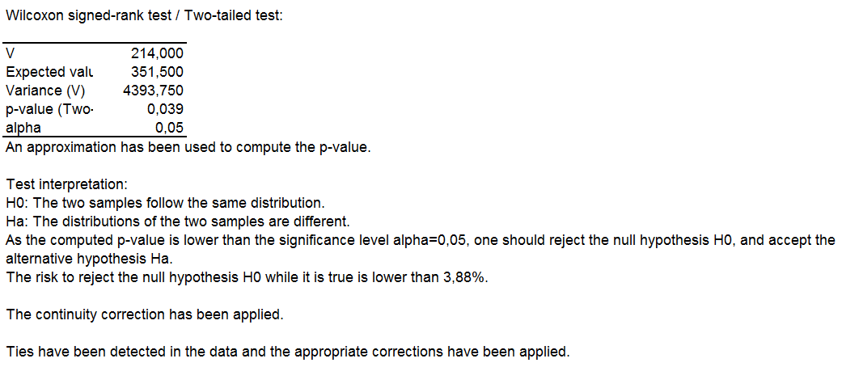
Wilcoxon Signed-Rank Test
Using the data from the case study 1, we compared the year 2007 and 2015 using non parametrics tests.
As we can see in this case we have to reject the null hypothesis that they follow a same distribution.

Slide 134
Mann-Whitney Test
The Mann-Whitney test is a non parametric test that allows to compare two independent samples.
It will allow you to test for differences between two conditions in which different participants have been used
This is accomplished by ranking the data rather than using the means for each group
• Lowest score = a rank of 1
• Next highest score = a rank of 2, and so on
• Tied ranks are given the same rank: the average of the potential ranks
• The analysis is carried out on the ranks rather than the actual data

Slide 135
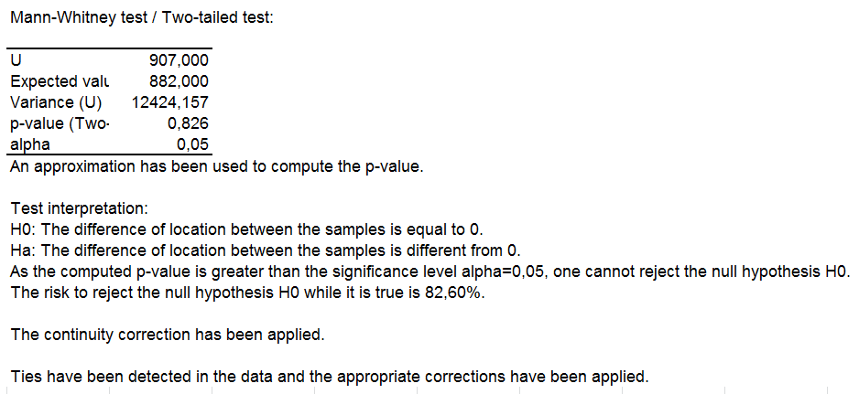
Mann-Whitney Test
Using the data from the case study 1, we compared the year 2007 and 2015 using non parametrics tests.
Here the p-value is higher than the alpha so you cannot reject the null hyppothesis.

Slide 136
Krustal-Wallis Test
The Kruskal-Wallis test (Kruskal& Wallis, 1952) is the non-parametric counterpart of the oneway independent ANOVA
– If you have data that have violated an assumption then this test can be a useful way around the problem
• The theory for the Kruskal-Wallis test is very
similar to that of the Mann-Whitney U and Wilcoxon test,
– Like the Mann-Whitney test, the Kruskal-Wallis test is based on ranked data.
– The sum of ranks for each group is denoted by Ri (where i is used to denote the particular group)

Slide 137
Krustal-Wallis Test
Once the sum of ranks has been calculated for each group, the test statistic, H, is calculated as:
– Ri is the sum of ranks for each group
– N is the total sample size (in this case 80)
– ni is the sample size of a particular group (in this case we have equal sample sizes and they are all 20)

Slide 138
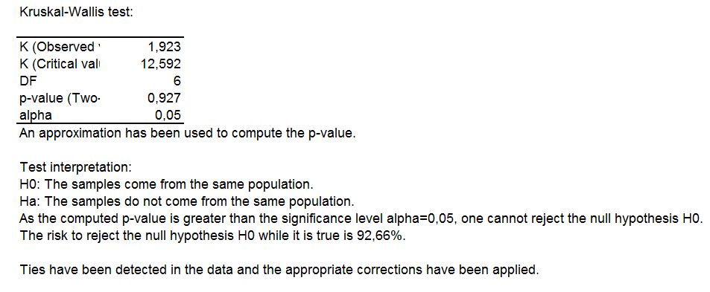
Krustal-Wallis Test
Here, we compare samples from 2009 to 2015:
Again here the p-value is higher than the alpha so one cannot reject the null hypothesis

Slide 139
Friedman Test
This test is used to test for differences between groups with ordinal dependent variables. It can also be used for continuous data if the one-way ANOVA with repeated measures is inappropriate.
Used for testing differences between conditions when:
There are more than two conditions:
There is dependency between the groups (naturally occurring pairs, researcher-produced pairs, repeated measures)
The theory for Friedman’s ANOVA is much the same as the other tests: it is based on ranked data.

Slide 140
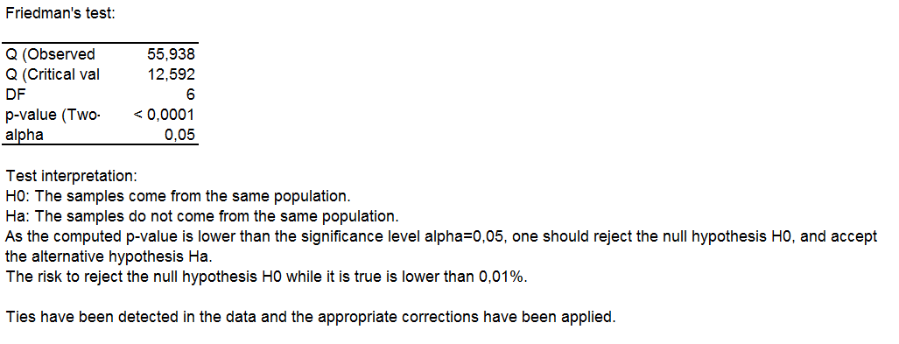
Friedman Test
We used the same data as before (2009-2015)
Here the p-value is lower than the alpha then one can reject the null hypothesis.

Slide 141
Spearman Rank Correlation
The Spearman Rank Order Correlation coefficient, rs, is a non-parametric measure of the strength and direction of linear association that exists between two variables measured on at least an ordinal scale.
The test is used for either ordinal variables or for interval data that has failed the assumptions necessary for conducting the Pearson's product-moment correlation
Assumptions:
Variables are measured on an ordinal, interval, or ratio scale
Variables do not need to be normally distributed
There is a linear relationship between the two variables
This type of correlation is not very sensitive to outliers

Slide 142
XL-STAT: Nonparametric Tests (1/2)
Go in XLSTAT →Non Parametric Tests→Comparison of Two samples
Or XLSTAT →Non Parametric Tests→Comparison of k samples
For every Nonparametric tests:
In « General » Tab :Select your data on « Sample»
Select the format of your data.
In Tests: select what tests fit you
Select where you want the tests : Range, Sheet or workbook
In « Options » Tab :
Alternative Hypothesis: choose what fits you. (only for Comparison for two distribution)
The significance level is 5% most all the time.
Check Asymptotic p-value

Slide 143
XL-STAT: Nonparametric Tests (2/2)
In « Outputs » Tab:
As you can see you can have also the Descriptive Statistics
In « Charts » Tab:
You can select the kind of chart you want..
Then you click on OK and the tests will appear.

Slide 144
Summary (1/3)
Type of Test: | Use:
Correlational | These tests look for an association between variables
Pearson correlation | Tests for the strength of the association between two continuous variables
Spearman correlation | Tests for the strength of the association between two ordinal variables (does not rely on the assumption of normal distributed data)
Chi-square | Tests for the strength of the association between two categorical variables

Slide 145
Summary (2/3)
Comparison of Means: look for the difference between the means of variables
T-Student (Paired T-) test | Tests for difference between two related variables
T-Student (Independent T-) test | Tests for difference between two independent variables
ANOVA | Tests the difference between group means after any other variance in the outcome variable is accounted for

Slide 146
Summary (3/3)
Non-parametric: are used when the data does not meet assumptions required for parametric tests
Wilcoxon rank-sum test | Tests for difference between two independent variables - takes into account magnitude and direction of difference
Wilcoxon sign-rank test | Tests for difference between two related variables - takes into account magnitude and direction of difference
Sign test | Tests if two related variables are different – ignores magnitude of change, only takes into account direction

Slide 147
Econometrics: Linear Regression
Chapter 6

Slide 148
Introduction
In this chapter we will study two types of regressions: linear regression and multiple regressions.
Regression is a method which consists to predict one variable from other variables.
Linear regression consists of finding the best-fitting straight line through the points.
Definition: Describing and evaluating the relationship between a given variable (called the dependent variable Y ) and one or more other variables (usually known as the independent variable(s), X1, X2, …Xk)
, t=1, 2, …T

Slide 149
Some definitions (Summary)
Simple linear regression is a statistical method that allows us to summarize and study relationship between two continuous variables.
In general, in linear regression, researchers use this parameters:
X is the variable regarded as the predictor, explanatory, exogenous or independent variables
Y is the variable called the response, endogenous or dependent variable.
β is a parameter vector
ε is called the error term, disturbance term or noise.

Slide 150
Simple Linear Regression: Definition
Linear regression consists of finding the best-fitting straight line through the points.
To do so, linear regression studies the link between 2 quantitative variables (X and Y), the model is:
Where
Y is the dependent variable
X is the independent variable or the explicative one
ε is the standard error term, noise or disturbance term
a, b are coefficients which are estimated according to the n observations of the samples.
→ It consists to predict Y according to a value X

Slide 151
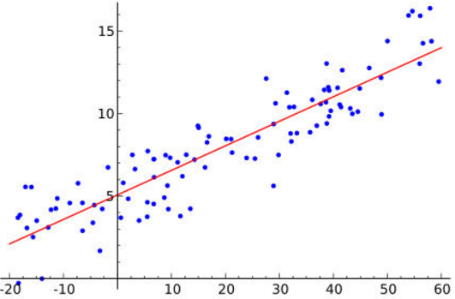
Simple Linear Regression: Scatter Diagram
The scatter Diagram is a good way to see if data follows a Best Fitting Line.
The red line is the slope of the Best Fitting Line
The equation of the Best fitting line is :

Slide 152
Simple Linear Regression: Hypothesis of the model
The standard error estimate is a measure of the accuracy of the predictions
The errors should be independent of each other.
The errors should be normally distributed with mean =0 and constant deviation.

Slide 153
Simple Linear Regression: Model Estimation
The coefficients, a and b are calculated like that :
First, we have to minimize the equation for the sum of the squared predictions errors:
MinΣ(ε_{i}² ) = min Σ[y_{i} – (a.x_{i} + b)]²
And get the « least squares estimates »:
and
are the estimated solution
are called also residuals

Slide 154
Simple Linear Regression Model: Confimation of the Model
Now, we have seen the model and how we calculate the coefficients a and b.
The next step of our analysis is to confirm the model. For that we have to do some tests on the coefficient and then we have to study the residu

Slide 155
Simple Linear Regression Model: Coefficient test a
Here our null hypothesis H0: a = 0 and our alternative hypothesis is H₁: a ≠ 0
In this case we have to use Student’s test
The statistic that we will use is:
Under H₀, T follows a Student distribution T(n-2)
We reject H₀ when T>2: there is a relationship between X and Y

Slide 156
Simple Linear Regression Model: Coefficient test b
Here our null hypothesis H0: b = 0 and our alternative hypothesis is H₁: b ≠ 0
In this case we have to use Student’s test
The statistic that we will use is:
Under H₀, T follows a Student distribution T(n-2)
We reject H₀ when T>2: there is a relationship between X and Y

Slide 157
Simple Linear Regression Model: Study of the Residuals
SSR is the « regression sum of squares » and quantifies how far the estimated sloped regression line, is from the horizontal « no relationship line » the sample mean or
SSE is the error sum of squares and quantifies how much the data points vary around the estimated regression line
SSTO is the total sum of squaresand quantifies how much the data points vary around their mean.

Slide 158
Simple Linear Regression Model: Study of the Residuals
First you should calculate the correlation between the two variables
|r(x;y)| = 1 : There is a perfect relationship between X and Y
r(x;y) = 0 : There is no relationship between X and Y
If r(x;y) is negative or positive that show us the slope of the relationship

Slide 159
Simple Linear Regression Model: R² the coefficient of determination
We define R² / R-Squared or (explained variation)
R² belongs to [0;1]
R² = 1 : perfect relationship between X and Y
R² = 0 : no relationship between X and Y

Slide 160
Simple Linear Regression: Example (1/4)
On this example we want to understand the relationship between the number of companies and the sales in the industry sector.
To do so, here
X is the number of companies (the independent variable)
Y is the sales (dependent variable)
 | Number of Companies | Sales
Belgium | 216 | 901,9
Bulgaria | 372 | 1 282,5
Czech Republic | 365 | 3 088,5
Denmark | 222 | 4 725,8
Estonia | 143 | 398,0
Ireland | 405 | 967,4
Greece | 371 | 686,3
Croatia | 233 | 2 721,6
Latvia | 277 | 224,3
Lithuania | 122 | 186,4
Luxembourg | 9 | 71,9
Hungary | 446 | 431,0
Austria | 348 | 2 090,1
Slovenia | 97 | 274,8
Slovakia | 176 | 581,6
Finland | 859 | 1 500,4
Sweden | 733 | 3 688,7
Iceland | 33 | 37,0
Switzerland | 212 | 2 073,5
Macedonia | 167 | 211,2

Slide 161
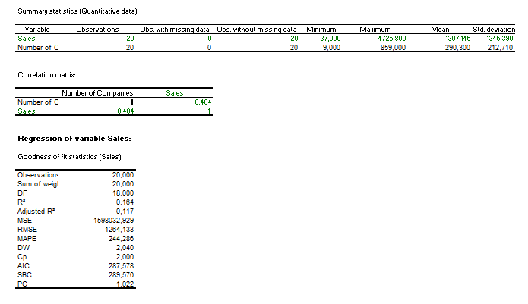
Simple Linear Regression: Example (2/4)
R² is close to 0 so the relationship between Sales and the number of companies is not strong.

Slide 162
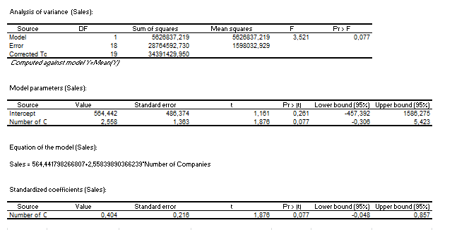
Simple Linear Regression: Example (3/4)
Sales = a * number of companies+ Intercept

Slide 163
Simple Linear Regression: Example (4/4)

Slide 164
Multiple Regression: Definition
Multiple regression studies the link between one quantitative variable (Y) and a set of independent quantitative variables X₁ , X₂ , …X_{n,} the model is:
With: Y: endogeneous variable
X₁ , X₂ , …X_{n} : Explicative variable
a₁ , a₂ , …a_{n} : (p+1) coefficients which have to be estimated according to the n observation
→ It is a Generalization of the Linear Regression.

Slide 165
Multiple Regression Regression: Hypothesis of the model
Hypothesis in the Standard Error Estimate are the same as the linear regression model
The standard error estimate is a measure of the accuracy of the predictions
The errors should be independent of each other.
The errors should be normally distributed with mean =0 and constant deviation.

Slide 166
Multiple Regression Regression: Model Estimation
The estimates of the a coefficients are the values that minimize the sum of squared errors for the sample
MSE is the Mean Squared Error:
estimates the variance of the errors : n is the sample size, p is the number of coefficient
is known as the residual standard error.

Slide 167
Multiple Regression: Model Estimation
The coefficients, a₁ , a₂ ,… are calculated like that :
First, we have to minimize the equation for the sum of the squared predictions errors:
MinΣ(ε_{i}² ) = min Σ[y_{i} – (a1.x_{i} +…+ a , x+b)]²
The solutions are
are the estimated solution
are called also residuals

Slide 168
Multiple Regression: Model Estimation
The same way we did for the linear regression model, here we have to realize some tests on the coefficients and also on the residuals to validate de model.

Slide 169
Multiple Regression: Tests of ANOVA
For this tests we will use the test of ANOVA with the hypothesis :
there is at least one a ≠ 0
The only issue here is that if we accept the hypothesis H₁ we do not know what is the coefficient equal to 0

Slide 170
Multiple Regression: Tests of ANOVA
This is the ANOVA table:
If the p-value is < 5% then you reject the null hypothesis.
Here the p-value is P(F(p;n-p-1)>Fα)
Source | Df | SS | MS | F
Regression | p-1 | SSR | MSR=SSR/(p-1) | MSR/MSE
Error | n-p | SSE | MSE=SSE/(n-p)
Total | n-1 | SSTO

Slide 171
Simple Linear Regression Model: Coefficient test a
Here our null hypothesis H0: a_{i} = 0 and our alternative hypothesis is H₁: a_{i} ≠ 0
In this case we have to use Student’s test
The statistic that we will use is:
Under H₀, T follow a Student distribution T(n-p-1)
We reject H₀ when T>Limit value of the t-test: there is a relationship between X and Y

Slide 172
Multiple Regression Model: Coefficient test b
Here our null hypothesis H0: b = 0 and our alternative hypothesis is H1: b ≠ 0
In this case we have to use Student’s test
The statistic that we will use is:
Under H₀, T follow a Student distribution T(n-p-1)
We reject H₀ when T> limit of the value of the t-test: there is a relationship between X and Y

Slide 173
Multiple Regression Model
To choose the best X_{i} which fits better to Y you should :
Test the model with all the variables.
Eliminate one buy one the variables according to the results of the Coefficients tests.

Slide 174
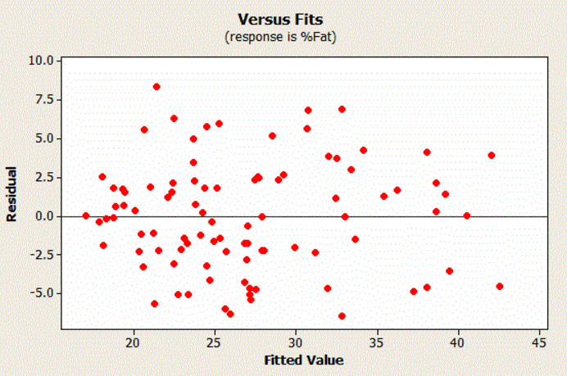
Multiple Regression Model: Study of the Residuals.
First you should check if the residuals are randomly distributed using graphs such as histograms, scattergrams, etc.
Here, we can see that the residuals are randomly distributed.

Slide 175
Multiple Regression Model: Study of the Residuals
First you should calculate the correlation between the two variables
|r(x;y)| = 1 : There is a perfect relationship between X and Y
r(x;y) = 0 : There is no relationship between X and Y
If r(x;y) is negative or positive that show us the slope of the relationship

Slide 176
Multiple Regression Model: R² the coefficient of determination
We define R² / R-Squared or (explained variation)
R² belongs to [0;1]
R² = 1 : perfect relationship between X and Y
R² = 0 : no relationship between X and Y
You can interpret the R² as : x% of the variation of Y are explained by the model.

Slide 177
Multiple Regression: Example (1/6)
On this example we want to understand the relationship between the number of companies, the turnover and the gross direct premium writtens in the financial sector.
To do so, here
X₂ is the gross direct premium writtens
X₁ is the number of companies (the independent variable)
Y is the turnover(dependent variable)

Slide 178
Multiple Regression: Example (2/6)
GEO/TIME | Number of Enterprises | Turnover | Gross Direct premium writtens
Belgium | 0 | 0 | 0
Bulgaria | 0 | 0 | 809,9
Czech Republic | 54 | 6 726,8 | 6 150,9
Denmark | 0 | 0 | 0
Germany | 669 | 237 506,0 | 0
Estonia | 13 | 335,8 | 325,5
Ireland | 0 | 0 | 0
Greece | 57 | 3 779,9 | 3 744,5
Spain | 271 | 60 822,0 | 56 052,0
France | 306 | 218 255,0 | 184 299,0
Italy | 137 | 108 362,0 | 105 310,7
Cyprus | 0 | 0 | 0
Latvia | 9 | 389,9 | 348,4
Lithuania | 11 | 331,2 | 330,5
Luxembourg | 0 | 0 | 0
Hungary | 30 | 2 586,4 | 2 562,5
Netherlands | 197 | 39 903,0 | 0
Austria | 48 | 18 686,4 | 16 327,9
Poland | 0 | 0 | 0
Portugal | 44 | 5 983,7 | 5 544,5
Romania | 41 | 1 816,2 | 1 809,7
Slovenia | 17 | 2 191,7 | 1 922,5
Slovakia | 18 | 1 956,9 | 1 937,2
Finland | 0 | 0 | 0
Sweden | 187 | 19 436,8 | 17 908,6
United Kingdom | 0 | 0 | 0
Iceland | 0 | 0 | 0
Norway | 51 | 16 177,8 | 16 036,0
Switzerland | 185 | 90 817,2 | 44 320,1

Slide 179
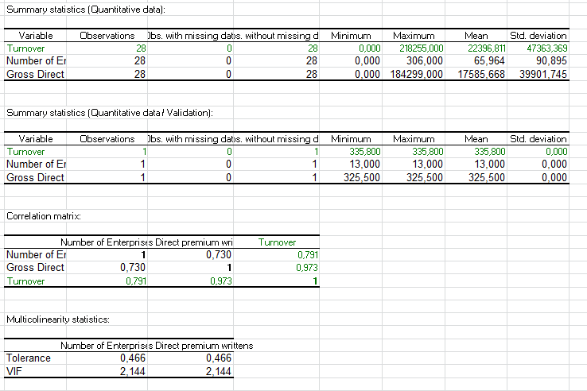
Multiple Regression: Example (3/6)

Slide 180
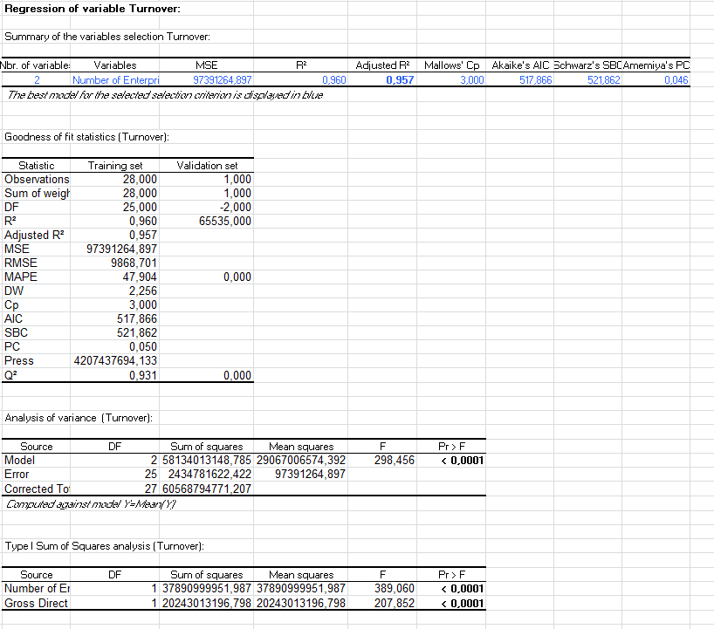
Multiple Regression: Example (4/6)
R² is R² is close to 1 so the relationship between Sales and the number of companies is strong.

Slide 181
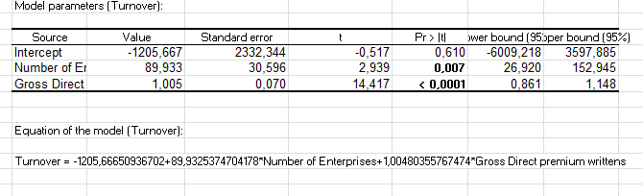
Multiple Regression: Example (5/6)
Sales = a1 * number of companies+a2*gross direct premium+ intercept

Slide 182
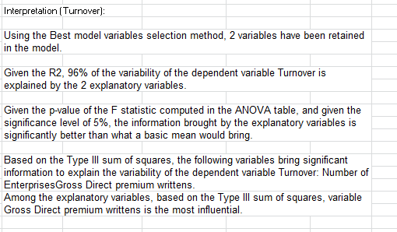
Multiple Regression: Example (6/6)
XLSTAT do the interpretation of the regression.
You can find it at the end of all the regression test.

Slide 183
Methodology
Define the variables of interest : Y, X1, X2, ..Xp
Global reliability of the model
Calculation of model coefficients
Reliability of each model coefficient
Goodness of fit
Assumptions to be checked on residuals of the model
Conclusion

Slide 184
XL-STAT: Linear regression(1/3)
Go in XLSTAT →Modeling Data → Linear Regression
In « General » Tab :
Select your Dependent Variables and your Explanatory Variables
In « Outputs » Tab:
You can check all the Outputs: Interpretation will ease you to do the understanding of the results.

Slide 185
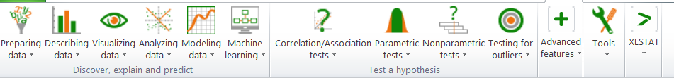
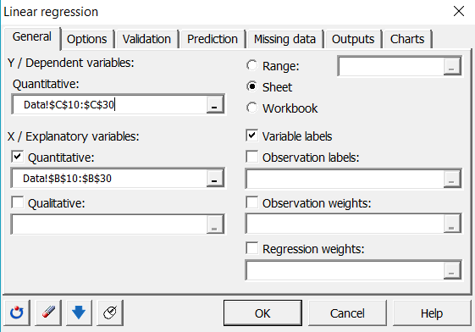
XL-STAT: Multiple Regressions (2/3)

Slide 186
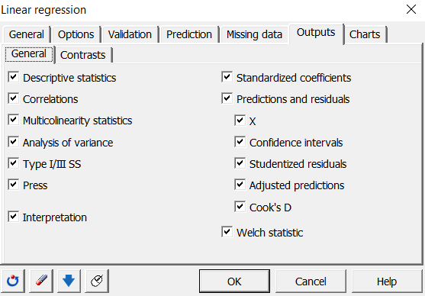
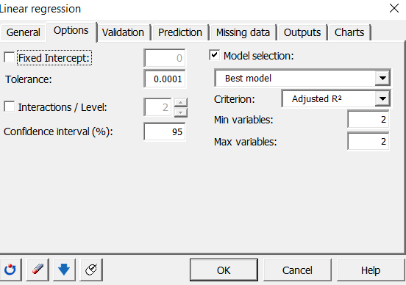
XL-STAT: Multiple Regressions (3/3)

Slide 187
References
For the Course:
Wegner, T. (2010). Applied business statistics: Methods and Excel-based applications. Juta and Company Ltd.
Rakotomalala, R. (2008). Tests de normalité. Université Lumière Lyon.
Valerie J. Easton and John H. McColl's Statistics Glossary v1.1
A First Course in Probability Models and Statistical Inference, James H.C. Creighton
Jeremy Orloff, and Jonathan Bloom. 18.05 Introduction to Probability and Statistics. Spring 2014. Massachusetts Institute of Technology: MIT OpenCourseWare, https://ocw.mit.edu. License: Creative Commons BY-NC-SA.
Hogg, R. V., & Tanis, E. A. (1977). Probability and statistical inference (Vol. 993). New York: Macmillan.
Online Statistics Education: A Multimedia Course of Study Project Leader: David M. Lane, Rice University.
Hatekar, Neeraj : Principles of Econometrics: An introduction (using R)
Patrick K. Watson and Sonja S. Teelucksingh: A Practical Introduction to Econometric Methods: Classical and Modern
Introductory Econometrics: A Modern Approach, Wooldridge Jeffrey M. (2009),4th ed., South-Western
Case Studies coming from Eurostat

